Slide 1
Cyclist
Marketing Report
by Daniel Buron
October 2024

Slide 2
Business Task
The task is to analyze Cyclistic's historical bike trip data to identify differences in usage patterns between annual members and casual riders, in order to provide insights that can be leveraged to convert more casual riders into annual members. This analysis will focus on key metrics such as ride length, trip frequency, time of usage, and popular routes, aiming to reveal distinctive behaviors and preferences that can inform targeted marketing strategies.

Slide 3
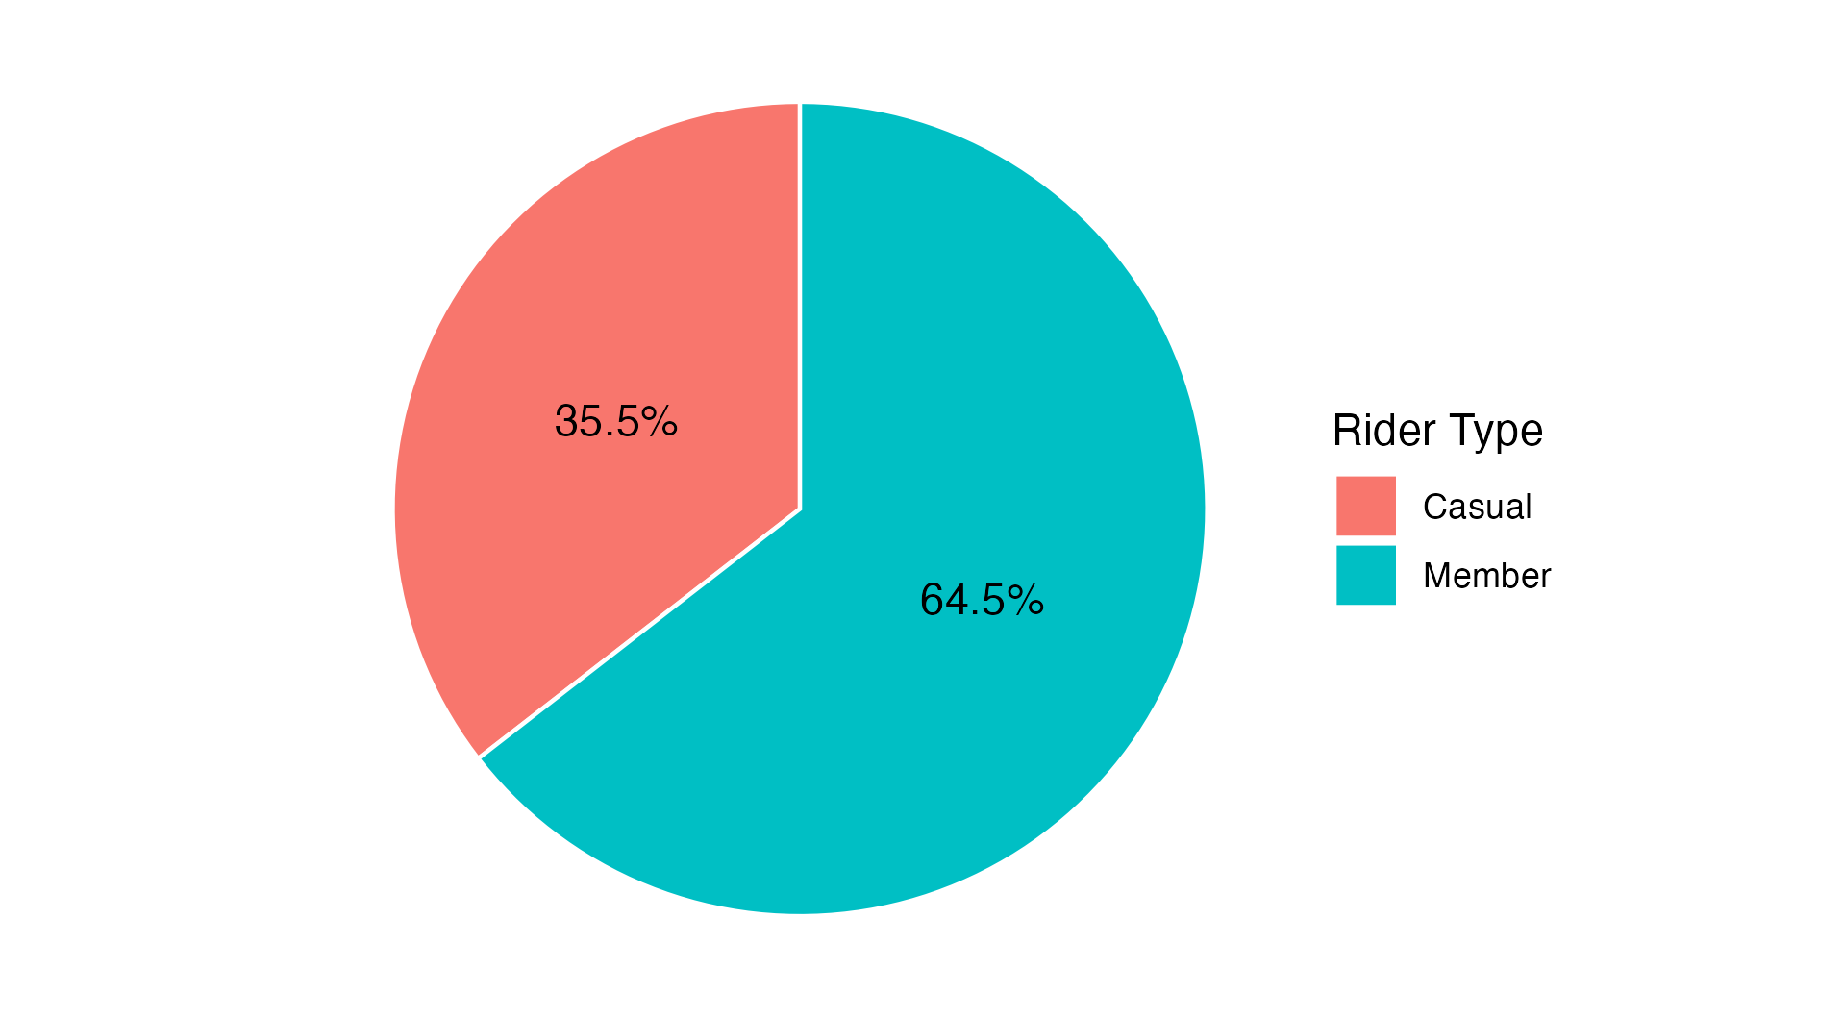
Descriptive Statistics
Metric | Value
Start Date | July 01, 2023
End Date | June 30, 2024
Casual Rides | 1,935,738
Member Rides | 3,517,059
Datapoints | 70,908,500
An analysis of Cyclist's ridership was conducted over a time period stretching from July 01, 2023, to June 30, 2024. The assessment observed a sample of 1,935,738 casual rides and 3,517,059 membership rides. *All data assessed was downloaded from the following website: https://divvy-tripdata.s3.amazonaws.com/index.html. The data has been made available by Motivate International Inc. This is public data that you can use to explore how different customer types are using Cyclistic bikes. No personally identifiable information exists in this data due to data privacy issues.

Slide 4
DOCUMENTATION

Slide 5
Documentation: Cleaning
• RStudio was used on a local computer for the entire cleaning process. The initial step involved loading necessary R packages such as data.table, dplyr, and ggplot2. To streamline the process, the script checks for missing packages and installs them as needed. • All CSV files were located in a specified directory, bike_share_data. In order to ensure data consistency across files, column names and data types from each CSV file were compared through a custom function, get_col_info, which used the fread function from the data.table package to read the first 100 rows of each file. My script then compared these structures against a reference file (the first file in the list) to identify and report any discrepancies in column names or data structures amongst all files. • To check for files with mismatching structures, a comparison was performed to pinpoint the exact differences, such as missing columns or data type mismatches. This was done by my custom function, print_detailed_diff, which highlighted the specific inconsistencies. Two of my CSV files were flagged for blank cells. I replaced the blank cells with NA, but did this after I combined all my individual CSV files into a single dataset. • This consolidation was achieved through a loop that read each file, converted it to a data frame for compatibility with `dplyr` functions, and then combined it with the main dataset using bind_rows. The cleaned and combined dataset was then saved in two formats: as a CSV for easy access and as an FST file. • The last bit of cleaning occurred after calculating the total number of data points within the dataset and before calculating the rest of the descriptive statistics seen in the prior slide. I created a new column `ride_length_minutes`, calculating the duration of each ride in minutes by taking the difference between the `ended_at` and `started_at` timestamps. I filtered out rides with zero or negative durations, counting and printing such instances across different rider types (e.g., 'casual' or 'member'). The dataset is filtered further to exclude these invalid rides for subsequent analysis.

Slide 6
Documentation: Manipulation
• I started my data manipulation by calculating summary statistics by rider type: the mean ride length, maximum ride length in hours, and the mode of ride initiation day. Column names are adjusted for readability, replacing underscores with spaces and capitalizing words. The results are formatted into a styled table using the flextable package (table seen at bottom of page). • I created a ride_length_minutes histogram (Scott’s) of the data and found the data bunched close to 0 (ie. More shorter than longer rides observed) and slightly influenced by outliers. I then calculated total counts for different ride duration categories (bins) ranging from 30 seconds to over 120 minutes. The summarise function in `dplyr` is used to compute these totals and analyze the data by rider type (`member_casual`), calculating both counts for each duration category. I visualized this data in a side by side bar plot. • I then manipulated and visualized the data for weekday trends, casual weekend ride counts based on ride lenght, seasonal ride count trends, round count trends in the 2 months with the highers number of casual rides, and finally, trends around the most popular bike stations. * Powerpoint development and rendering was done through use of the Officer package.
Rider Type | Ride Length (Mean) | Ride Length (Max Hours) | Day of Week (Mode)
Casual | 22 | 114 | Saturday
Member | 12 | 24 | Wednesday

Slide 7
ANALYSIS

Slide 8
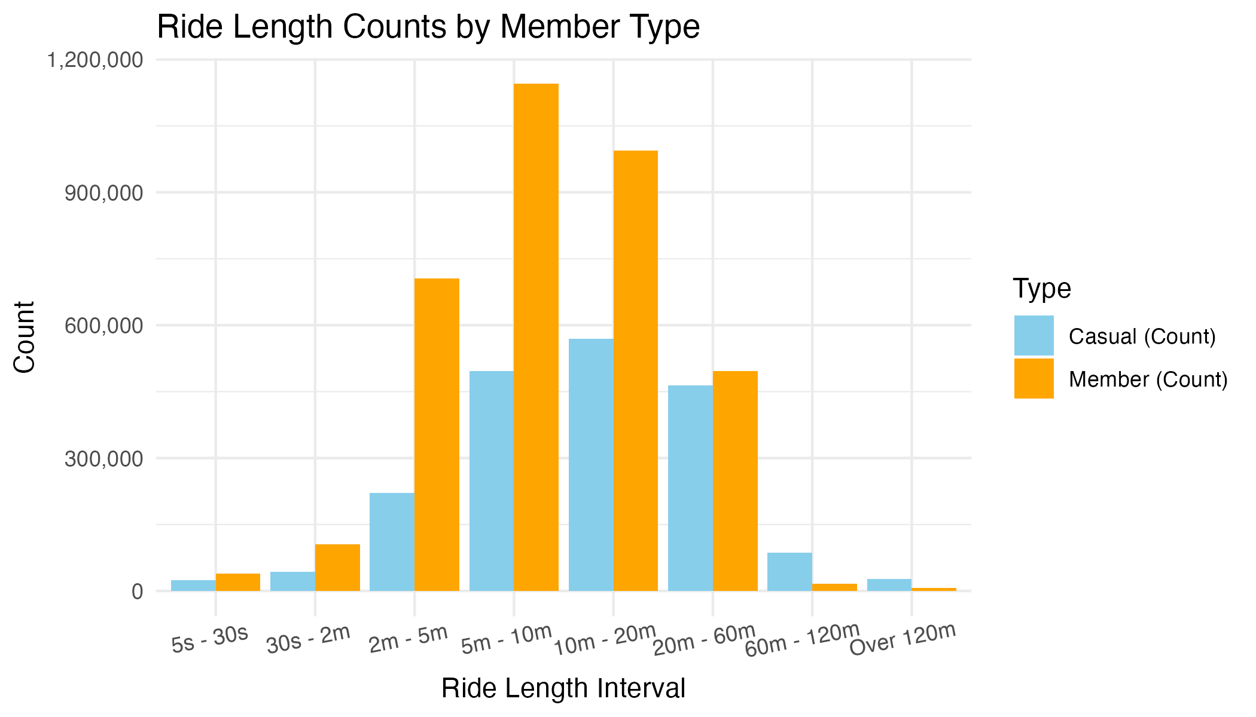
Analysis: Ride Interval Length
Interval | Casual Count | Member Count
5s - 30s | 24,870 | 39,507
30s - 2m | 42,618 | 104,849
2m - 5m | 220,753 | 705,314
5m - 10m | 496,316 | 1,145,129
10m - 20m | 569,106 | 994,528
20m - 60m | 464,283 | 496,419
60m - 120m | 87,060 | 16,678
Over 120m | 27,390 | 7,286
• Member riders record the highest number of rides in the 5-10m, 10-20m, and 2-5m ride length ranges. • Casual riders record the highest number of rides in the 5-10m, 10-20m, and 20-60m ride length ranges.

Slide 9
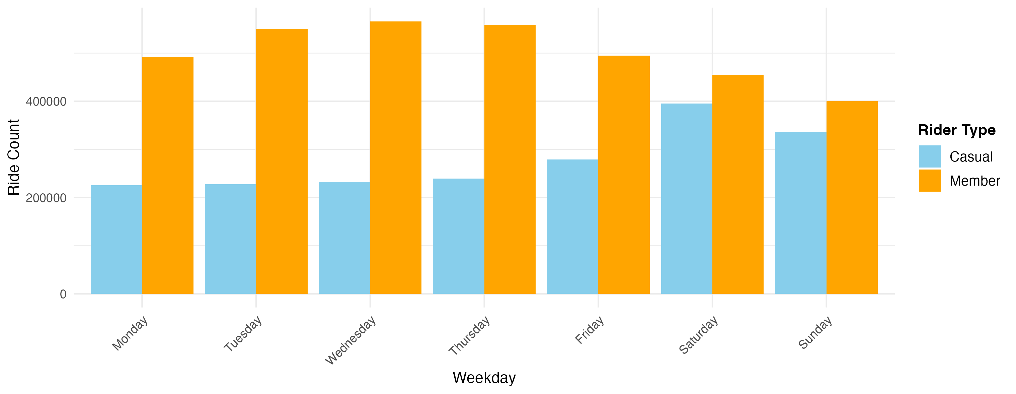
Analysis: Weekday
• Casual Riders have the highest number of rides on Friday (278,989), Saturday (395,033), & Sunday (336,459). • Member Riders have the highest number of rides on Tuesday(550,297), Wednesday(566,186), and Thursday(558,780).

Slide 10
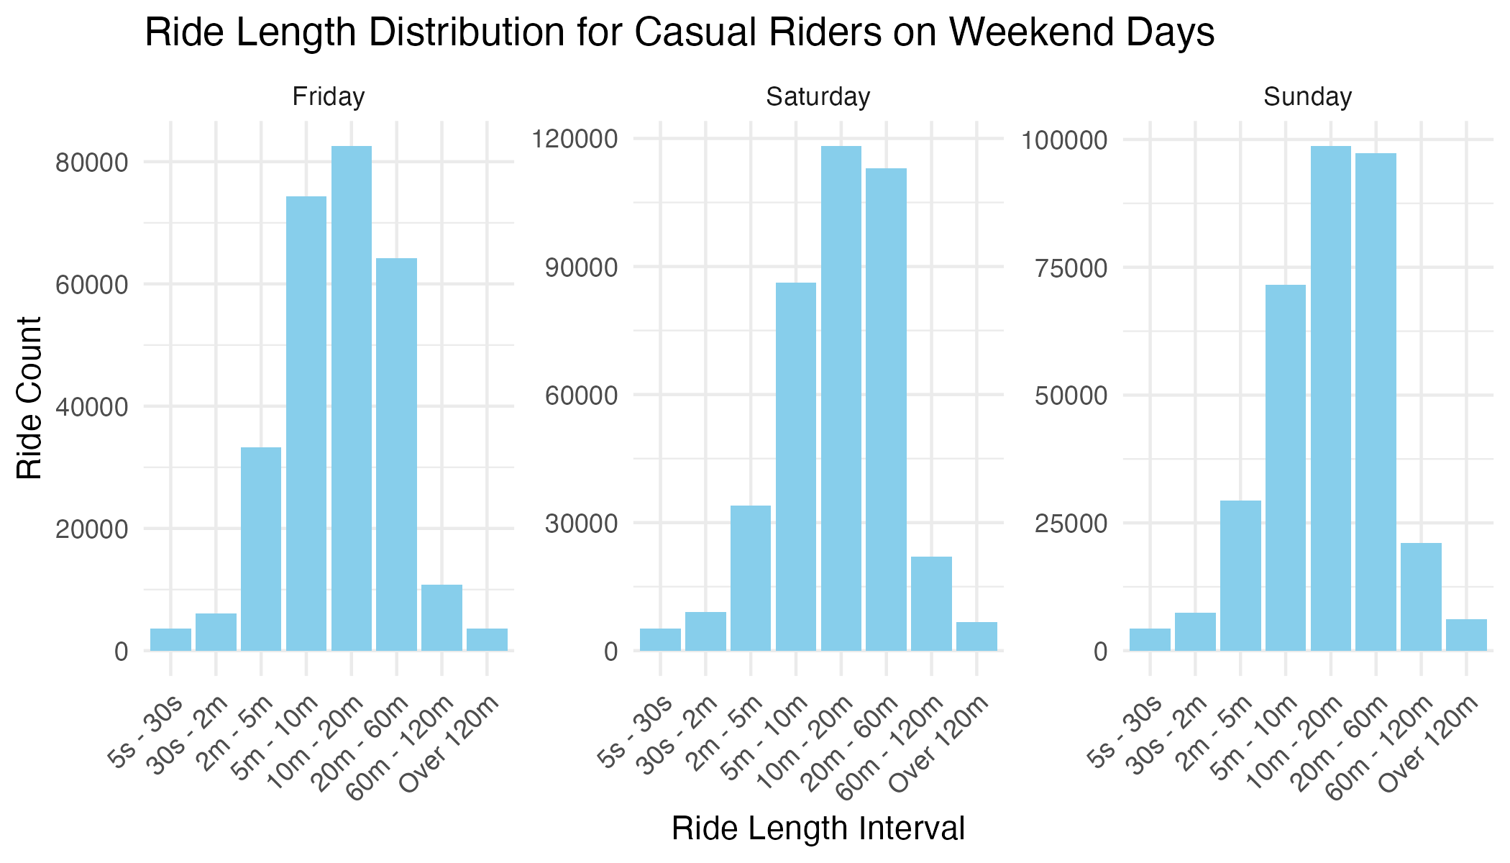
Analysis: Weekend Casual Riders
Interval | Friday | Saturday | Sunday
5s to 30s | 3,642 | 5,227 | 4,294
30s to 2m | 6,086 | 9,011 | 7,409
2m to 5m | 33,275 | 33,913 | 29,402
5m to 10m | 74,366 | 86,269 | 71,608
10m to 20m | 82,533 | 118,181 | 98,685
20m to 60m | 64,210 | 112,930 | 97,326
60m to 120m | 10,797 | 22,076 | 21,039
over 120m | 3,591 | 6,708 | 6,162
• On Saturday and Sunday, 10m - 20m and 20m - 60m ride lengths have the highest number of rides. • Ride lengths of 10m - 20m and 5m - 10m ride have the highest number of rides on Friday.

Slide 11
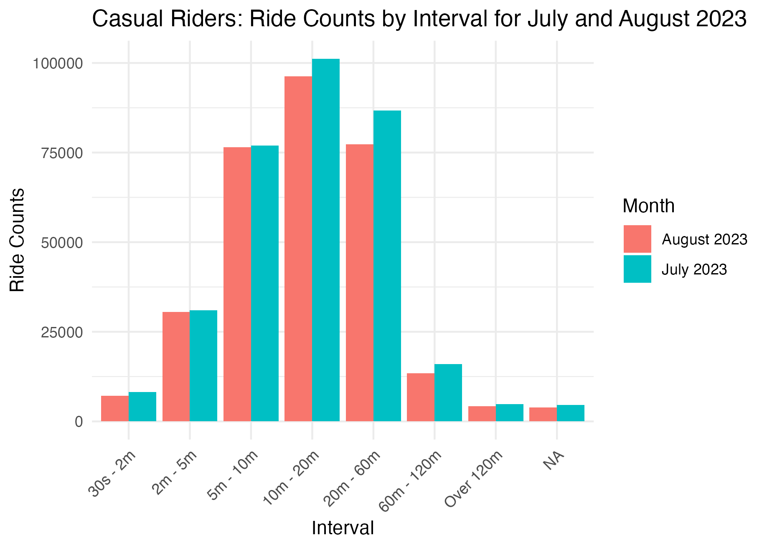
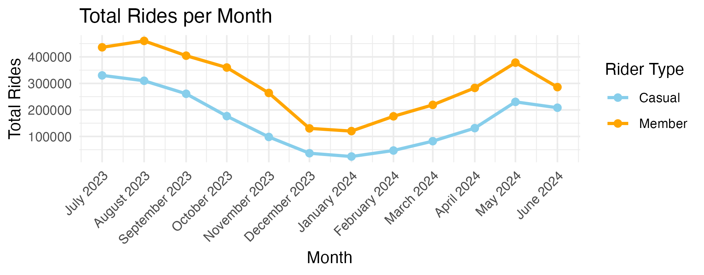
Analysis: Seasonal
• August, July, September, and May had the highest rider counts for Casual and Member riders. • July and August 2023 were the months with the highest rider counts and 10m – 20m, 20m – 60m and 5m - 10m were the most common length of rides during those months.

Slide 12
Analysis: Popular Routes
Top 5 Route Counts: Casual
Top 5 Route Counts: Member
Start Station | End Station | Route Count | Avg. Ride Length (minutes)
Unknown | Unknown | 152,418 | 12.4
Streeter Dr & Grand Ave | Streeter Dr & Grand Ave | 8,745 | 38.4
DuSable Lake Shore Dr & Monroe St | DuSable Lake Shore Dr & Monroe St | 7,328 | 34.8
DuSable Lake Shore Dr & Monroe St | Streeter Dr & Grand Ave | 4,807 | 27.2
Michigan Ave & Oak St | Michigan Ave & Oak St | 4,394 | 48.7
Start Station | End Station | Route Count | Avg. Ride Length (minutes)
Unknown | Unknown | 208,253 | 11.9
Calumet Ave & 33rd St | State St & 33rd St | 5,680 | 5.4
State St & 33rd St | Calumet Ave & 33rd St | 5,674 | 4.5
Ellis Ave & 60th St | University Ave & 57th St | 4,074 | 4.9
University Ave & 57th St | Ellis Ave & 60th St | 4,067 | 4.9
• The above tables display the Top 5 Routes for Casual and Member riders along with the average ride length per route. • Casual riders have longer average ride lengths on their top 5 most popular routes than Member riders. • If data collection is accurate, it appears that it's popular for Casual riders to start and end at the same station, suggesting they are touring a specific area at leisure rather than commuting purposes. • A large amount of Start and End Station data for both Member and Casual riders is missing, suggesting a data collection issue that requires further investigation.

Slide 13
CONCLUSION

Slide 14
CONCLUSION
Key Findings • Casual riders have the highest number of rides on Friday (278,989), Saturday (395,033), and Sunday (336,459), while member riders peak on Tuesday (550,297), Wednesday (566,186), and Thursday (558,780). • Casual riders show increased activity on Saturdays and Sundays, particularly for ride lengths between 10-20 minutes and 20-60 minutes. • The highest rider counts for both casual and member riders occur in August, July, September, May, and June. Recommendations • Target marketing efforts on weekends (Saturday and Sunday) and Fridays, when casual riders are most active. • Prepare campaigns for August, July, September, May, and June to align with peak casual rider activity. • Gear marketing initiatives towards the most frequent ride lengths for casual riders: 10-20 minutes, 20-60 minutes, and 5-10 minutes. • Enhance marketing at popular stations and routes frequented by casual riders, like Streeter Dr & Grand Ave and DuSable Lake Shore Dr & Monroe St.

